Slide 1
DDS Analytics Attrition and Salary Analysis
Sabrina Purvis
DS 6306
Notes:
Hi, I am Sabrina Purvis, a Data scientist hear to discuss with you, DDS Analytics, the drivers and key metrics around attrition and salary in your workforce.

Slide 2
Meeting Agenda
Understanding the drivers in attrition
Proper Prediction of Attrition
Understanding the factors of Salary
Proper Prediction of Salary

Slide 3
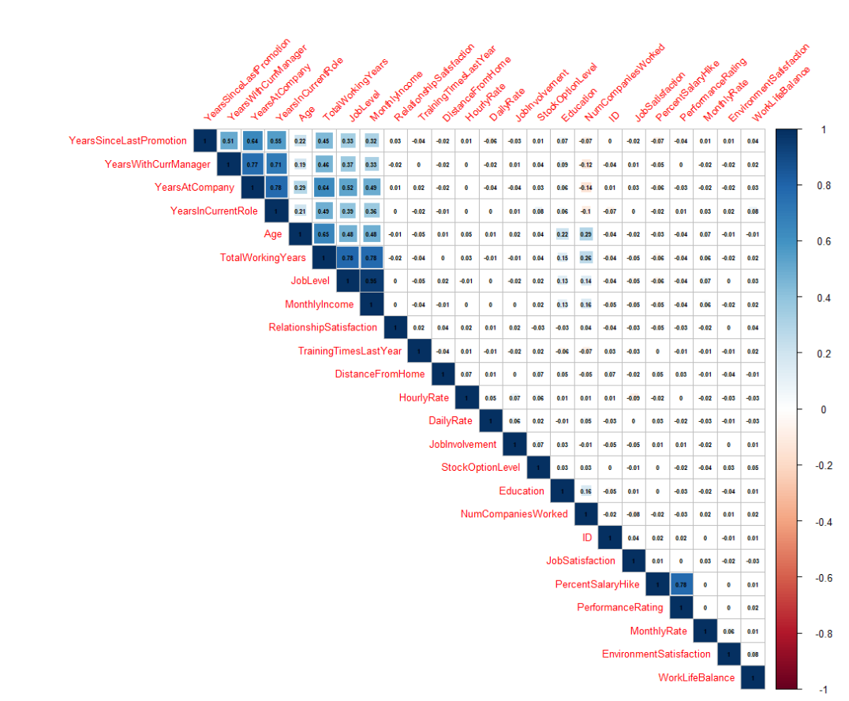
Understanding Attrition
Correlation assessment
Shows high correlation between all of the various ‘Years’ variables
Job Level, Total Working Years and Monthly Income are similarly correlated
Performance ratings (understandably) correlate to a higher percentage salary increase
Notes:
So lets first start with attrition. I need to begin by framing the picture for you of the dataset. There are dozens of variables presented, both categorical and continuous. When we have this many variables, it is important to first assess collinearity to ensure we are not penalizing the model with too many like variables. As shown in the graph, there is significant correlation in the variables all identified as “number of years”. Further, Job Level, working years and monthly income are similarly correlated. Finally performance ratings understandably correlate to higher percentage salary increases

Slide 4
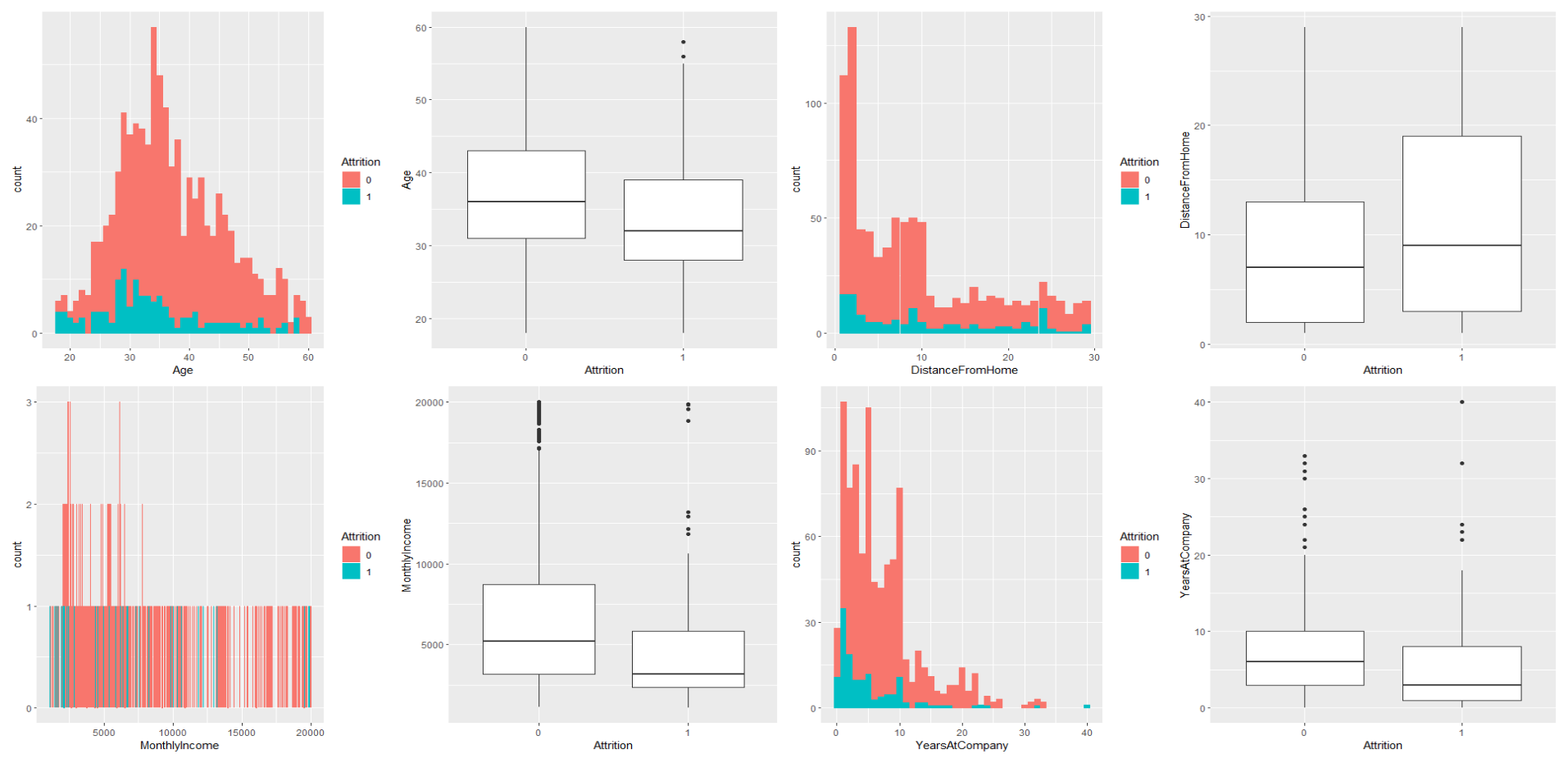
Understanding Attrition
Key Variable Reviews
Notes:
When reviewing the key continuous (or numeric) variables, I first visually assessed disparate findings between yes and no for attrition in each variable. Unsurprising, most variables have intuitive, common sense, findings. The age of the employee generally shows a higher chance for attrition the younger they are. The distance the employee drives is not a factor. Income, as it gets higher appears to drive down attrition. Tenure also plays a part. As employees work more years, they are less likely to leave.

Slide 5
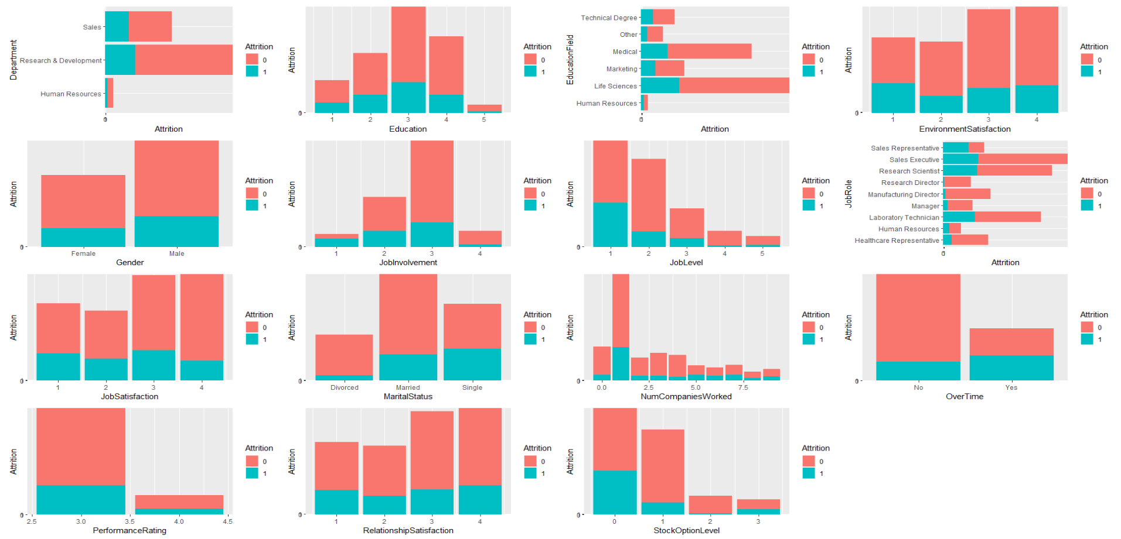
Understanding Attrition
Key Variable Reviews
Notes:
I next assessed your categorical variables. Again visual inspection provides insight. A few key items stand out. Gender does NOT factor into attrition. Marital status does however matter, where single people are more likely to leave. Attrition is significant in the lowest job levels when compared to the higher ones. Working overtime also drives up attrition. Stock Option elections drive down attrition. Finally, the general satisfaction in the relationship between employer and employee protects against attrition.

Slide 6
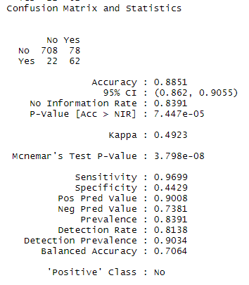
Predicting Attrition
Attrition is impacted by the following Attributes:
Business travel
Department, Education and Education field
Environment and Relationship Satisfaction
Job level, role and involvement
Overtime, performance ratings and marital status

Slide 7
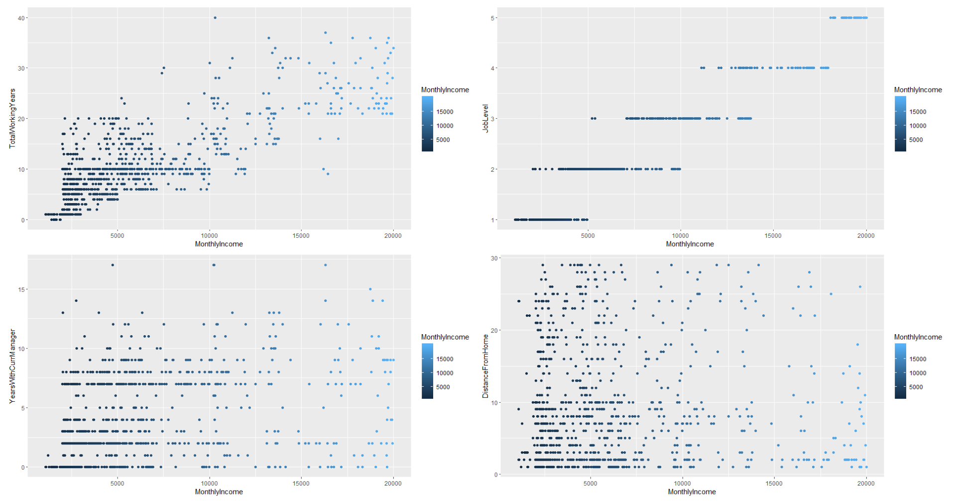
Defining Income
Key Variable Reviews
Notes:
When looking at salary, I again discovered that a handful of continuous variables could accurately predict the salary. Total Working years, Job Level, Years with current manager and distance from home all visually demonstrate a relationship between salary and the variable.

Slide 8
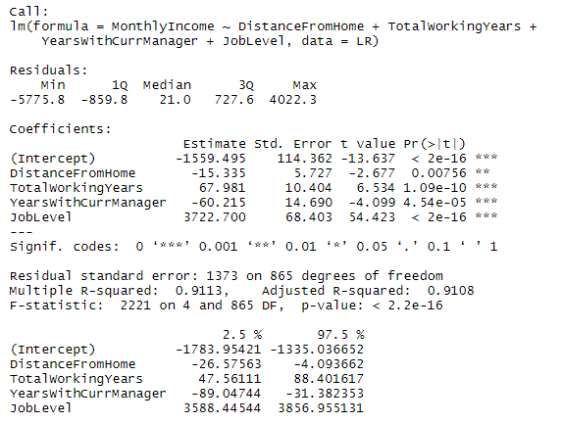
Predicting Income
Income can, in fact, be predicted.
Income is a linear relationship accounting for increases based on total working years and job level and slight decreases based on distance form home and current years with their manager
Notes:
Income – it turns out – can be predicted to a residual standard error of 1373. Income is a linear relationship and it’s increases can be decided bases on total working years and job level. It decreases slightly with distance from home and years with current manager. That really indicates that as your employees stay with a manager, their annual value doesn’t grow at the same rate as it would with fresh management. That may be due to job changes, but it certainly is significant.

Slide 9
Conclusion
Retaining workforce requires
Stock Options
Limited to no overtime
Overall relationship satisfaction
Appropriate salary
Setting appropriate salary should account for:
Job Level
Distance of travel
Total working years
Notes:
We are clearly here to talk about how to retain your team and pay the appropriately for their work.

